Slide 1

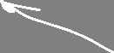


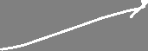
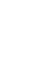


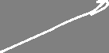
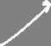
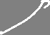


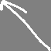
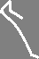
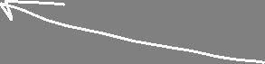

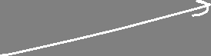
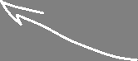


Linear regression, optimization, penalization, model selection
Angelo Ziletti, PhD
Principal Data Scientist, Bayer AG

Slide 2
Lecture 1 Outline
Part 1.
Linear regression as ML problem
1
Part 2.
Optimization: gradient descent, optimization vs ML problem
2
Part 3.
Model selection: underfitting and overfitting
3
Part 4.
Physics examples
4

Slide 3
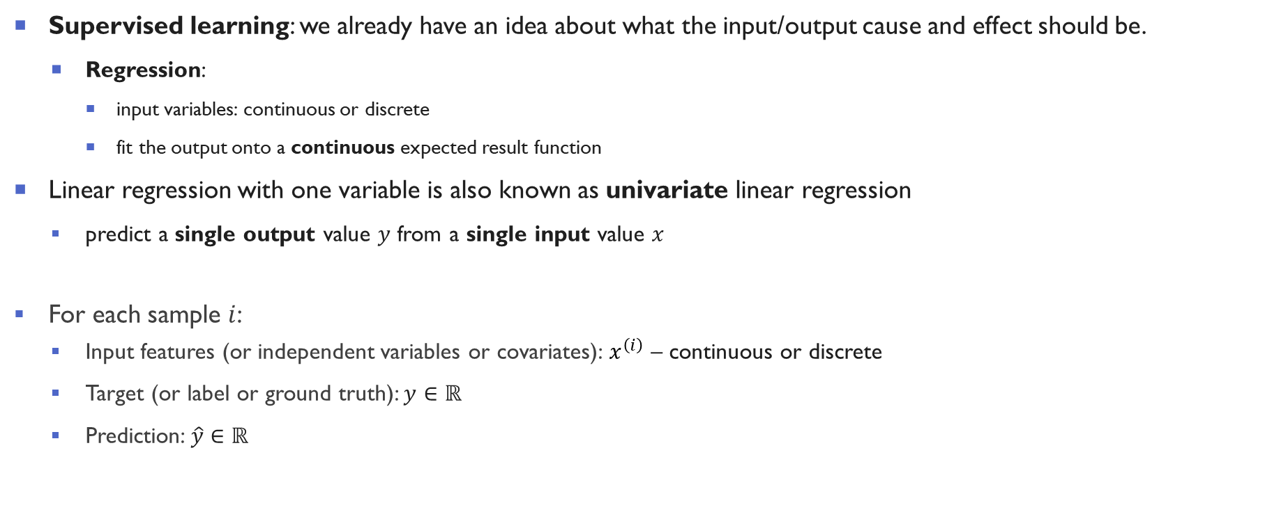
Linear Regression with one variable
Supervised learning: we already have an idea about what the input/output cause and effect should be.
Regression:
input variables: continuous or discrete
fit the output onto a continuous expected result function
Linear regression with one variable is also known as univariate linear regression
predict a single output value $y$ from a single input value $x$
For each sample $i$:
Input features (or independent variables or covariates): $x^{\left(ⅈ\right)}$ – continuous or discrete
Target (or label or ground truth): $y∈ℝ$
Prediction: $\hat{y}∈ℝ$

Slide 4
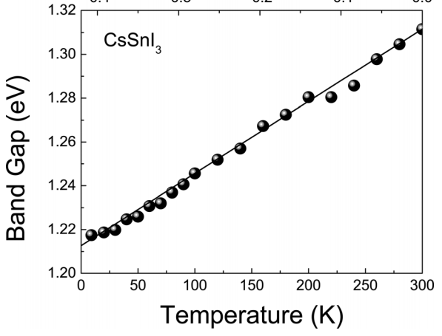

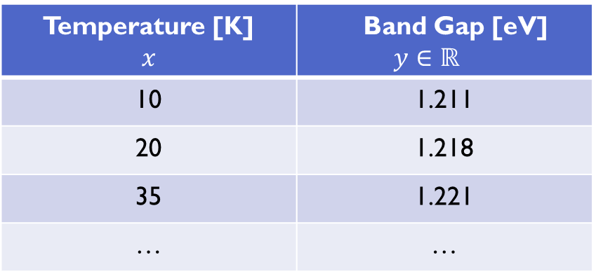

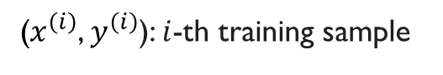
Linear regression: example
Temperature [K] $$x$$ | Band Gap [eV] $$y∈ℝ$$
10 | 1.211
20 | 1.218
35 | 1.221
… | …
($x^{\left(ⅈ\right)}$, $y^{\left(ⅈ\right)}$): $i$-th training sample
Band gaps of perovskite semiconductor CsSnI₃ at various temperatures deduced from photoluminescence spectra [*]
[*] :Yu et al., J. Appl. Phys. 110, 063526 (2011)
Notes:
Physics example: bandgap as a function of temperature: 2011JofAppliedPhysicsEgT.pdf (cuny.edu)
Temperature dependence of the band gap of perovskite semiconductor compound CsSnI3

Slide 5
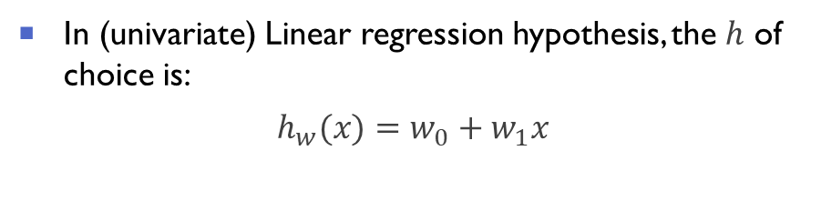
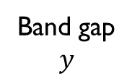
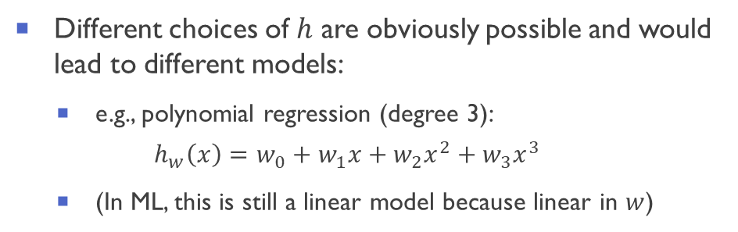
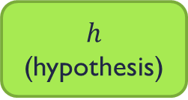
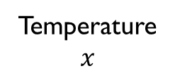
Model representation
Training set
How do we represent $h$?
In (univariate) Linear regression hypothesis, the $h$ of choice is:
$$h_{w}(x)=w_{0}+w_{1}x$$
Learning algorithm
$$h$$
(hypothesis)
Temperature
$$x$$
Band gap
$$y$$
Different choices of $h$ are obviously possible and would lead to different models:
e.g., polynomial regression (degree 3):
$$h_{w}\left(x\right)=w_{0}+w_{1}x+w_{2}x^{2}+w_{3}x^{3}$$
(In ML, this is still a linear model because linear in $w$)
The hypothesis $h$maps from the input $x$to $y$

Slide 6



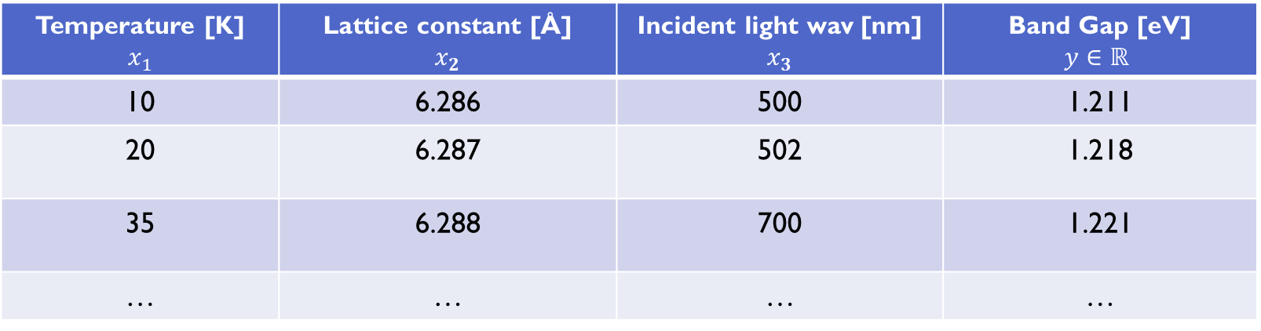
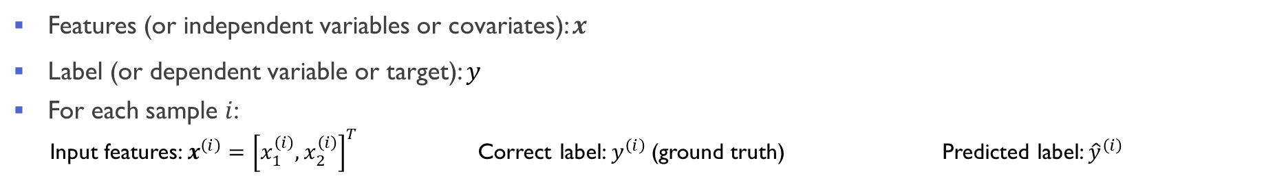
Multivariate Linear Regression: example
Temperature [K] $$x_{1}$$ | Lattice constant [Å] $$x_{2}$$ | Incident light wav [nm] $$x_{3}$$ | Band Gap [eV] $$y∈ℝ$$
10 | 6.286 | 500 | 1.211
20 | 6.287 | 502 | 1.218
35 | 6.288 | 700 | 1.221
… | … | … | …
Features (or independent variables or covariates): $x$
Label (or dependent variable or target): $y$
For each sample $i$:
Input features: $x^{\left(ⅈ\right)}={\left[x_{1}^{\left(i\right)},x_{2}^{\left(i\right)}\right]}^{T}$ Correct label: $y^{\left(ⅈ\right)}$ (ground truth) Predicted label: ${\hat{y}}^{\left(ⅈ\right)}$

Slide 7
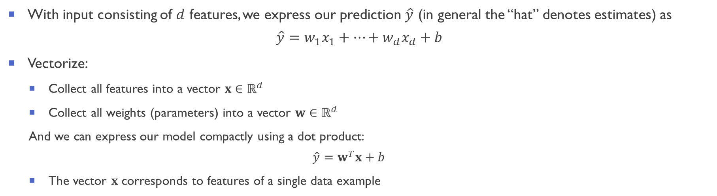
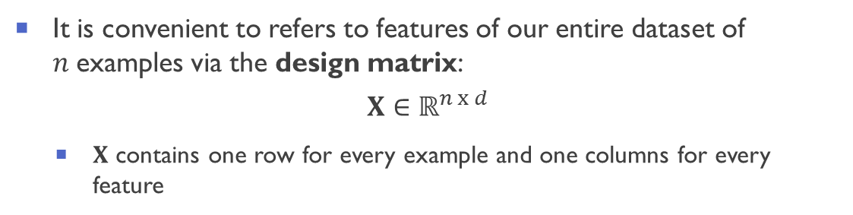
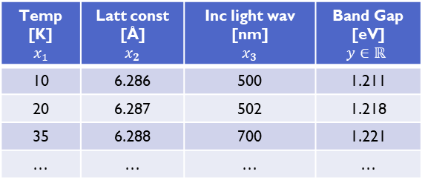
Multivariate Linear Regression
With input consisting of $d$ features, we express our prediction $\hat{y}$ (in general the “hat” denotes estimates) as
$$\hat{y}=w_{1}x_{1}+⋯+w_{d}x_{d}+b$$
Vectorize:
Collect all features into a vector $x∈ℝ^{d}$
Collect all weights (parameters) into a vector $w∈ℝ^{d}$
And we can express our model compactly using a dot product:
$$\hat{y}=w^{T}x+b$$
The vector $x$ corresponds to features of a single data example
It is convenient to refers to features of our entire dataset of $n$examples via the design matrix:
$$X∈ℝ^{n x d}$$
$X$ contains one row for every example and one columns for every feature
Temp [K] $$x_{1}$$ | Latt const [Å] $$x_{2}$$ | Inc light wav [nm] $$x_{3}$$ | Band Gap [eV] $$y∈ℝ$$
10 | 6.286 | 500 | 1.211
20 | 6.287 | 502 | 1.218
35 | 6.288 | 700 | 1.221
… | … | … | …
Notes:
3.1. Linear Regression — Dive into Deep Learning 0.16.7 documentation (d2l.ai)

Slide 8
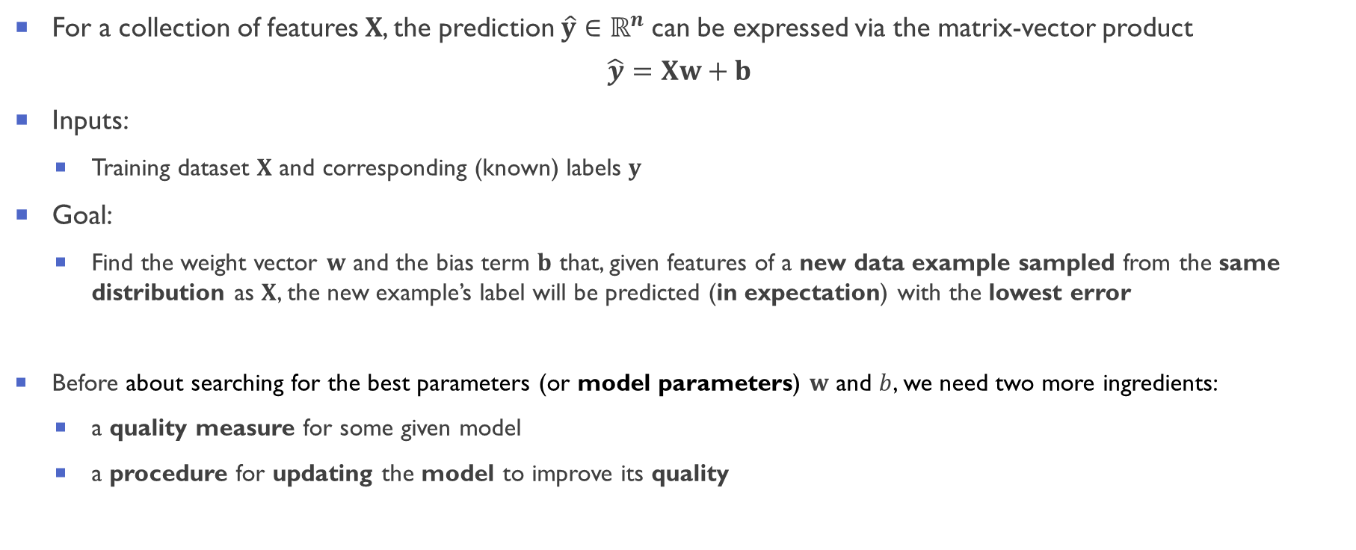
Multivariate Linear Regression
For a collection of features $X$, the prediction$\hat{y}∈ℝ^{n}$ can be expressed via the matrix-vector product
$$\hat{y}=Xw+b$$
Inputs:
Training dataset $X$ and corresponding (known) labels $y$
Goal:
Find the weight vector $w$ and the bias term $b$ that, given features of a new data example sampled from the same distribution as $X$, the new example’s label will be predicted (in expectation) with the lowest error
Before about searching for the best parameters (or model parameters) $w$ and $b$, we need two more ingredients:
a quality measure for some given model
a procedure for updating the model to improve its quality
Notes:
3.1. Linear Regression — Dive into Deep Learning 0.16.7 documentation (d2l.ai)

Slide 9
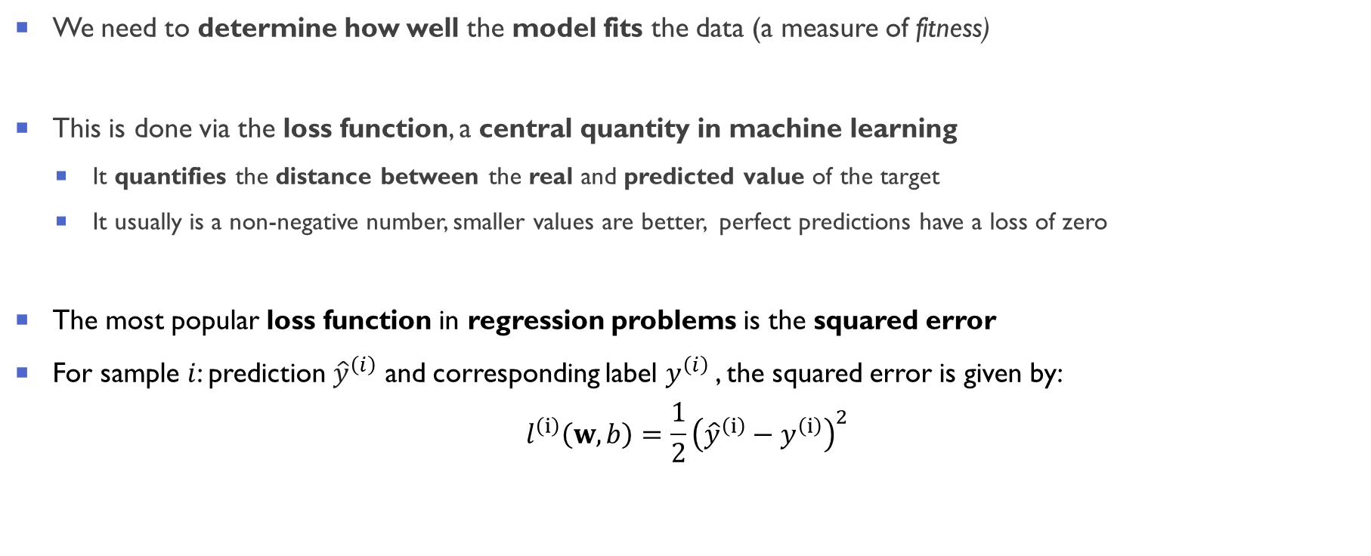
How do we measure the quality of our predictions?
We need to determine how well the model fits the data (a measure of fitness)
This is done via the loss function, a central quantity in machine learning
It quantifies the distance between the real and predicted value of the target
It usually is a non-negative number, smaller values are better, perfect predictions have a loss of zero
The most popular loss function in regression problems is the squared error
For sample $i$: prediction ${\hat{y}}^{\left(ⅈ\right)}$ and corresponding label $y^{\left(ⅈ\right)}$, the squared error is given by:
$$l^{\left(ⅈ\right)}\left(w,b\right)=\frac{1}{2}{\left({\hat{y}}^{\left(ⅈ\right)}−y^{\left(ⅈ\right)}\right)}^{2}$$

Slide 10
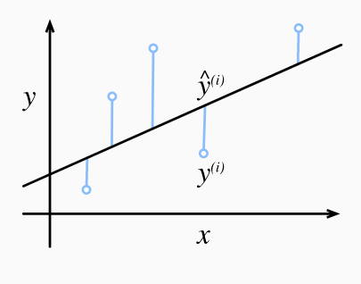
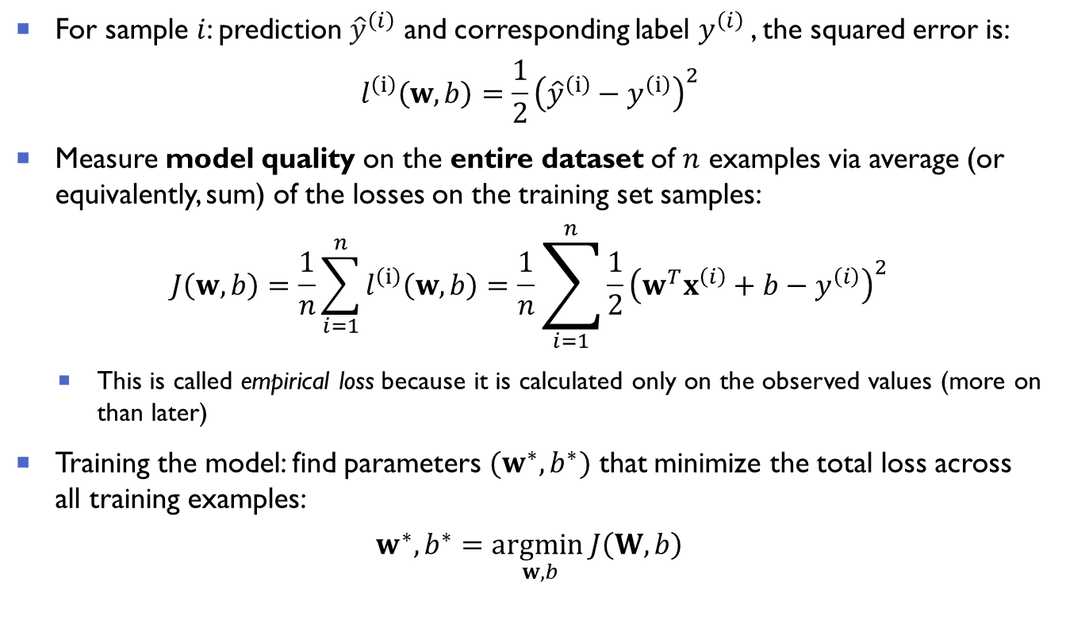

Loss function for linear regression
For sample $i$: prediction ${\hat{y}}^{\left(ⅈ\right)}$ and corresponding label $y^{\left(ⅈ\right)}$, the squared error is:
$$l^{\left(ⅈ\right)}\left(w,b\right)=\frac{1}{2}{\left({\hat{y}}^{\left(ⅈ\right)}−y^{\left(ⅈ\right)}\right)}^{2}$$
Measure model quality on the entire dataset of $n$ examples via average (or equivalently, sum) of the losses on the training set samples:
$$J\left(w,b\right)=\frac{1}{n}\sum_{i=1}^{n}{l^{\left(ⅈ\right)}\left(w,b\right)}=\frac{1}{n}\sum_{i=1}^{n}{\frac{1}{2}{\left(w^{T}x^{\left(i\right)}+b−y^{\left(i\right)}\right)}^{2}}$$
This is called empirical loss because it is calculated only on the observed values (more on than later)
Training the model: find parameters ${(w}^{∗},b^{∗})$ that minimize the total loss across all training examples:
$$w^{∗},b^{∗}=\underset{w, b}{\text{arg}min}J\left(W,b\right)$$
Figure from 3.1. Linear Regression — Dive into Deep Learning 0.17.0 documentation (d2l.ai)

Slide 11
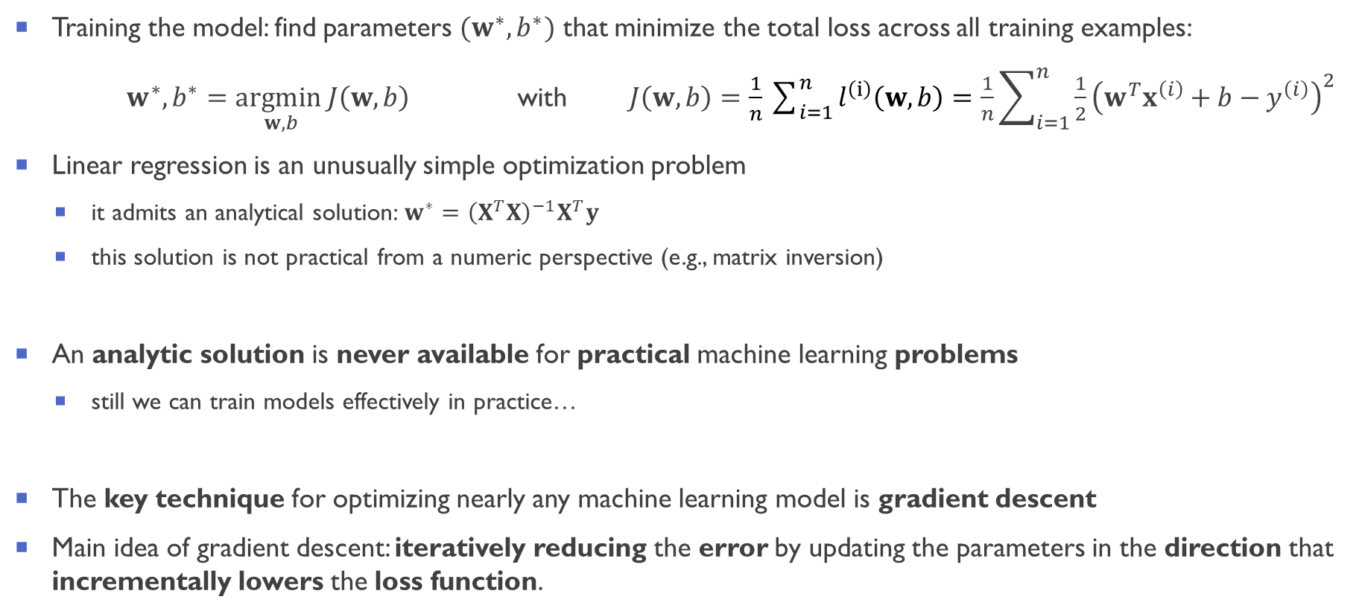
Finding the best parameters: model optimization
Training the model: find parameters ${(w}^{∗},b^{∗})$ that minimize the total loss across all training examples:
$w^{∗},b^{∗}=\underset{w, b}{\text{arg}min}J\left(w,b\right)$ with $J\left(w,b\right)=\frac{1}{n}\sum_{i=1}^{n}{l^{\left(ⅈ\right)}\left(w,b\right)}=\frac{1}{n}\sum_{i=1}^{n}{\frac{1}{2}{\left(w^{T}x^{\left(i\right)}+b−y^{\left(i\right)}\right)}^{2}}$
Linear regression is an unusually simple optimization problem
it admits an analytical solution:$w^{∗}={\left(X^{T}X\right)}^{−1}X^{T}y$
this solution is not practical from a numeric perspective (e.g., matrix inversion)
An analytic solution is never available for practical machine learning problems
still we can train models effectively in practice…
The key technique for optimizing nearly any machine learning model is gradient descent
Main idea of gradient descent: iteratively reducing the error by updating the parameters in the direction that incrementally lowers the loss function.

Slide 12
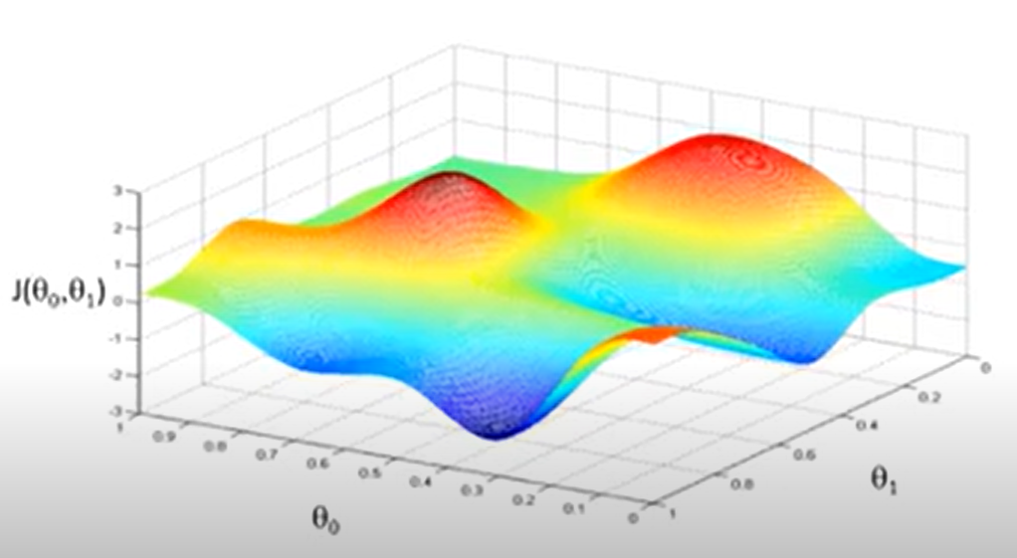
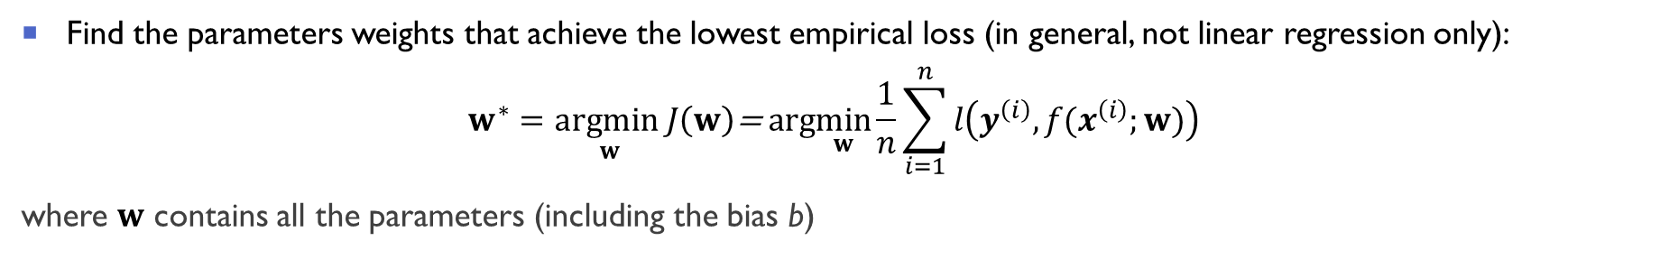
Optimization: empirical loss optimization
Find the parameters weights that achieve the lowest empirical loss (in general, not linear regression only):
$$w^{∗}=\underset{w}{\text{arg}min}J\left(w\right)\text{= }\text{arg}\min_{w}\frac{1}{n}\sum_{i=1}^{n}{l\left(y^{\left(ⅈ\right)},{f(x}^{\left(ⅈ\right)};w)\right)}$$
where $w$ contains all the parameters (including the bias b)
We would like to do something like this…
Figure from Andrew Ng, Machine Learning, Coursera (https://www.coursera.org/learn/machine-learning)

Slide 13
GRADIENT DESCENT

Slide 14
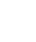

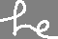

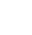
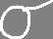
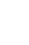

Slide 15
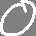
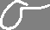
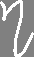
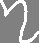
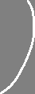

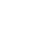


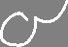
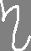

Slide 16
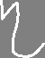
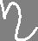



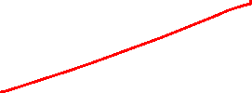
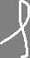



Slide 17
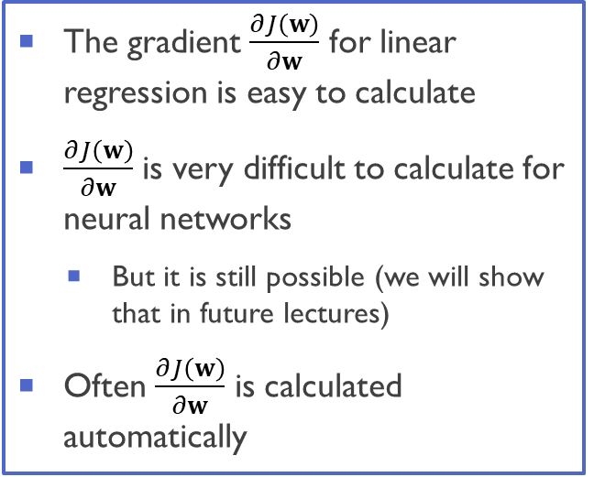



Gradient Descent Algorithm
$f$ is our loss function $J\left(w\right)=\frac{1}{n}\sum_{i=1}^{n}{l\left(y^{\left(ⅈ\right)},{f(x}^{\left(ⅈ\right)};w)\right)}$
Gradient Descent Algorithm:
Initialize $w$ randomly (multiple strategies possible)
Loop until convergence:
Compute gradient $\frac{∂J\left(w\right)}{∂w}$
Update weights $w←w−η\frac{∂J\left(w\right)}{∂w}$
Return weights
The gradient $\frac{∂J\left(w\right)}{∂w}$ for linear regression is easy to calculate
$\frac{∂J\left(w\right)}{∂w}$ is very difficult to calculate for neural networks
But it is still possible (we will show that in future lectures)
Often $\frac{∂J\left(w\right)}{∂w}$ is calculated automatically

Slide 18



Linear regression: making predictions
Linear regression model (one sample):
$$\hat{y}=w^{T}x+b$$
Via optimization (gradient descent), goal was to find the best parameters ${(w}^{∗},b^{∗})$ that minimize the loss function
$$w^{∗},b^{∗}=\underset{w, b}{\text{arg}min}J\left(w,b\right)$$
After training for some predetermined number of iterations (or until some other stopping criteria), we have the estimated model parameters $(\hat{w}$, $\hat{b} )$ (an estimate of the exact minimizers $w^{∗},b^{∗}$)
Given temperature $x_{1}$, lattice constant $x_{2}$, and incident light wavelength $x_{3}$ (not contained in the training data)
we can now estimate the band gap via the learned linear regression model ${\hat{w}}^{T}x+\hat{b}$
Estimating targets given features is called prediction (or inference)
Temp [K] $$x_{1}$$ | Latt const [Å] $$x_{2}$$ | Inc light wav [nm] $$x_{3}$$ | Band Gap [eV] $$y∈ℝ$$
10 | 6.286 | 500 | 1.211
20 | 6.287 | 502 | 1.218
35 | 6.288 | 700 | 1.221
… | … | … | …

Slide 19


Time to recap: our first modelling task
Training set: features, labels
Hypothesis function: model
Example: linear regression $\hat{y}=w^{T}x+b$
How well are we doing?
Loss function: $J\left(w,b\right)=\frac{1}{n}\sum_{i=1}^{n}{l^{\left(ⅈ\right)}\left(w,b\right)}$
Example: squared error: $J\left(w,b\right)=\frac{1}{n}\sum_{i=1}^{n}{l^{\left(ⅈ\right)}\left(w,b\right)}=\frac{1}{n}\sum_{i=1}^{n}{\frac{1}{2}{\left(w^{T}x^{\left(i\right)}+b−y^{\left(i\right)}\right)}^{2}}$
How do we find the actual parameters?
Loss optimization via gradient descent: $w←w−η\frac{∂J\left(W\right)}{∂w}$
How do we use the model:
Estimate the target by using the learned model
Example: ${\hat{y}}_{pred}= {\hat{w}}^{T}x+\hat{b}$
Temperature [K] $$x_{1}$$ | Lattice constant [Å] $$x_{2}$$ | Incident light wav [nm] $$x_{3}$$ | Band Gap [eV] $$y∈ℝ$$
10 | 6.286 | 500 | 1.211
35 | 6.288 | 700 | 1.221
… | … | … | …

Slide 20
Optimization, ml problem under & OVER fitting

Slide 21

Optimization or machine learning problem?
Given the loss $J\left(W\right)=\frac{1}{n}\sum_{i=1}^{n}{l\left(y^{\left(ⅈ\right)},{\hat{y}}^{\left(ⅈ\right)}\right)}=\frac{1}{n}\sum_{i=1}^{n}{l\left(y^{\left(ⅈ\right)},{f(x}^{\left(ⅈ\right)};W)\right)}$, it looks like the goal is to find the parameters that minimizes it:
$$W^{∗}=\underset{w}{\text{arg}min}J\left(W\right)\text{= }\text{arg}\min_{w}\frac{1}{n}\sum_{i=1}^{n}{l\left(y^{\left(ⅈ\right)},{f(x}^{\left(ⅈ\right)};W)\right)}$$
Optimization problems are solved all the time in physics (with much more complicated functional forms):
Ground state wavefunction of a quantum system:
$ψ^{GS}=\text{arg}\min_{ψ}\frac{\left\langle ψ\left|H_{ee}\right|y\right\rangle }{\left\langle \left.ψ\right|ψ\right\rangle }$ where $H_{ee}=T+V_{ee}+V_{ext}$
Ground state density (e.g. in density function theory):
$n^{GS}=\text{arg}\min_{n}E_{HK}\left[n\right]$ where $E_{HK}\left[n\right]=T\left[n\right]+V_{ee}\left[n\right]+V_{ext}\left[n\right]$
… but there we have never used regularization, or train/validation/test set and heuristics to solve these problems?
Why we need to deal with these techniques in machine learning?

Slide 22

How learning differs from pure optimization
The machine learning problem $W^{∗}=\underset{W}{\text{arg}min}J\left(W\right)$is not a pure (traditional) optimization problem
In machine learning, we care about some performance measure $A$, defined with respect to the test set (and may also be intractable)
$A$ is optimized only indirectly: we reduce a (different) cost function $J\left(W\right)$ hoping that doing so will improve $A$
This is in contrast to pure optimization, where minimizing J is the actual goal
Typically, the cost function can be written as an average over the training set, such as
$J\left(W\right)=\frac{1}{n}\sum_{i=1}^{n}{l\left({f(x}^{\left(ⅈ\right)};W),{\hat{y}}^{\left(ⅈ\right)}\right)}$= $𝔼_{\left(x,y\right)\sim {\hat{p}}_{data}}l\left(f\left(x,W\right);y\right)$
where ${\hat{p}}_{data}$ is the empirical distribution (what we observe through the training set!)

Slide 23

Expected generalization error
What we should actually minimize is the corresponding objective function where the expectation is taken across the true underlying data-generating distribution $p_{data}$ (rather than just over the finite training set):
$J^{∗}\left(W\right)=𝔼_{\left(x,y\right)\sim p_{data}}l\left(f\left(x,W\right),y\right)$ (1)
When we do not know $p_{data}$ (or it is too costly to compute) but only have a training set of samples, we have a machine learning problem
We thus optimize the empirical loss:
$J\left(W\right)=𝔼_{\left(x,y\right)\sim {\hat{p}}_{data}}l\left(f\left(x,W\right);y\right)$ = $\frac{1}{n}\sum_{i=1}^{n}{l\left({f(x}^{\left(ⅈ\right)};W),{\hat{y}}^{\left(ⅈ\right)}\right)}$ (2)
The goal of a machine learning algorithm is to reduce the expected generalization error given by equation (2)
Since we minimize (2) instead of (1), special techniques are needed (e.g. regularization, train/validation/test splits)

Slide 24








Slide 25


Underfitting, overfitting, and regularization
The central challenge in machine learning is that algorithms must perform well on new, previously unseen inputs
The ability to perform well on previously unobserved inputs is called generalization
Figure from d2l.ai
In modern machine learning models (e.g. deep learning): overfitting is usually the main problem (and not underfitting) because models are very flexible and complex
Regularization: collection of strategies to reduce model capacity in a “thoughtful way” to avoid overfitting
Notes:
Training and test error behave differently. Underfitting regime:
At the left end of the graph, training error and generalization error
are both high. As we increase capacity, training error
decreases, but the gap between training and generalization error increases. Eventually,
the size of this gap outweighs the decrease in training error, and we enter the overfitting
regime, where capacity is too large, above the optimal capacity.

Slide 26
REGULARIZATION

Slide 27


Regularization
Definition of regularization [1]: “any modification we make to a learning algorithm that is intended to reduce its generalization error but not its training error.”
Multiple strategies possible:
Constraints and penalties designed to express a generic preference for a simpler models to promote generalization (e.g. $L^{2}$ and $L^{1}$ penalization)
Multiple hypothesis that explain the training data are combined in ensemble methods (e.g. dropout)
Stop the optimization early according to “external” metric such as validation set performance (e.g. early stopping)
Encode specific kinds of prior knowledge (e.g. special architectures like convolutional neural networks)
These are specific of neural networks – we will see this later in the class
[1] Deep Learning, Goodfellow, Bengio, and Courville, MIT Press (2016)

Slide 28

An example: which model would you choose?
Let us consider the following linear predictor
$$\hat{y}=w_{1}x_{1}+w_{2}x_{2}+w_{3}x_{3}+b$$
Imagine we have three models that have exactly the same performance on the training set:
Model 1: $w_{1}=1.12$ $w_{2}=−0.15$ $w_{3}=0.72$
Model 2: $w_{1}=9.12$ $w_{2}=−8.11$ $w_{3}=1.72$
Model 3: $w_{1}=−3.12$ $w_{2}=6.15$ $w_{3}=−3.72$
Which model would you choose and why?
When there are many correlated variables in a linear regression model, their coefficients can become poorly determined and exhibit high variance
A wildly large positive coefficient on one variable can be cancelled by a similarly large negative coefficient on its correlated cousin
By imposing a size constraint on the (absolute value of the) coefficients, this problem is alleviated
Notes:
ESL Shrinkage methods

Slide 29

Parameter Norm Penalties
The most common regularization approach: limit model complexity (capacity) by adding a parameter norm penalty $Ω\left(w\right)$ to the loss function:
$$\tilde{J}(w)=J\left(w\right)+αΩ\left(w\right)$$
where:
$J\left(w\right)$: unregularized loss function
$Ω\left(w\right)$: parameter norm penalty
$\tilde{J}(w)$: regularized loss function
$α∈\left[0,∞\right)$ : (hyper)parameter that weights the relative contribution of $Ω$ relative to the standard loss function $J$
$α=0$: no regularization; $α$ large → large regularization
Training algorithm minimizes the regularized objective function $\tilde{J}(w)$
it will decrease both the original loss $J\left(w\right)$ on the training data AND some measure of the size of the parameters w
Different choices of $Ω\left(w\right)$ can result in different solutions being preferred

Slide 30










Slide 31



Slide 32



Slide 33



Slide 34



Notes:
Inverse = transpose for eigenvector matrix (linear algebra - In which cases is the inverse of a matrix equal to its transpose? - Mathematics Stack Exchange)
Inverse product of three matrices: linear algebra - Inverse of product of matrices - Mathematics Stack Exchange

Slide 35







$L^{2}$ regularization: effect on model coefficients
Regularized objective:
$$\tilde{J}\left(w\right)=J\left(w\right)+αΩ\left(w\right)=J\left(w\right)+\frac{α}{2}w^{T}w$$
Unregularized minimum: $w^{∗}=\underset{w}{\text{arg}min}J\left(w\right)$
Regularized minimum ${\tilde{w}}_{R}$:
$${\tilde{w}}_{R}=Q{\left(Λ+αI\right)}^{−1}ΛQ^{T}w^{∗}$$
The component of $w^{∗}$ that is aligned with the i-th eigenvector of $H$ is rescaled by a factor of $\frac{λ_{i}}{λ_{i}+α}$
$λ_{i}≫α$: the eigenvalues of $H$ are relatively large (large curvature) compared to the regularization parameter $α$
The effect of the regularization is relatively small
$λ_{i}≪α:$ the eigenvalues of $H$ are small (low curvature) compared to the regularization parameter $α$
This components will be shrunk to have nearly zero magnitude
$$R$$
Original figure from Deep Learning, MIT Press Book (https://www.deeplearningbook.org/)
Notes:
An illustration of the effect of L2 (or weight decay) regularization on the value
of the optimal w. The solid ellipses represent contours of equal value of the unregularized
objective. The dotted circles represent contours of equal value of the L2 regularizer. At
the point w˜, these competing objectives reach an equilibrium. In the first dimension, the
eigenvalue of the Hessian of J is small. The objective function does not increase much
when moving horizontally away from w∗. Because the objective function does not express
a strong preference along this direction, the regularizer has a strong effect on this axis.
The regularizer pulls w1 close to zero. In the second dimension, the objective function
is very sensitive to movements away from w∗. The corresponding eigenvalue is large,
indicating high curvature. As a result, weight decay affects the position of w2 relatively
little.

Slide 36

Our first hyperparameter: the regularization $α$
Recall the regularized loss function:
$$\tilde{J}(w)=J\left(w\right)+αΩ\left(w\right)$$
$α∈\left[0,∞\right)$ : (hyper)parameter that weights the relative contribution of $Ω$ relative to the standard loss function $J$
$α=0$: no regularization; $α$ large → large regularization
The $α$ determines the strength of the regularization
The regularization $α$ is a “special” parameter because its optimal value is not automatically determined by the optimization procedure (unlike the $w$)
Parameters of this type are called hyperparameters
The hyperparameters are determined via model selection (more on that later)

Slide 37

$L^{2}$ regularization example: linear regression
For linear regression, the (unregularized) loss function is the sum of squared errors
$$J\left(w\right)={\left(Xw−y\right)}^{T}\left(Xw−y\right)$$
The analytical solution (normal equations) reads:
$$w={\left(X^{T}X\right)}^{−1}X^{T}y$$
If the add the regularization to the loss function, we obtain:
$$\tilde{J}\left(w\right)={\left(Xw−y\right)}^{T}\left(Xw−y\right)+\frac{1}{2}αw^{T}w$$
The analytical solution becomes:
$$w_{R}={\left(X^{T}X+αI\right)}^{−1}X^{T}y$$
The new matrix is the same as the original one, but with the addition of α to the diagonal (ridge regression)
The matrix $X^{T}X$is proportional to the covariance matrix; diagonal entries correspond to the variance of each input feature
$L^{2}$ regularization causes the learning algorithm to “perceive” the input $X$ as having higher variance, which makes it shrink the weights on features whose covariance with the output target is low compared to this added variance
Notes:
L2 regularization causes the learning algorithm to “perceive” the input X as having higher variance, which makes it shrink the weights on features whose covariance with the output target is low compared to this added variance

Slide 38

$L^{1}$ regularization
In $L^{1}$ regularization, the parameter norm penalty is:
$$Ω\left(w\right)={\left\|w\right\|}_{1}=\sum_{i}{\left|w_{i}\right|}$$
The regularized objective function $\tilde{J}\left(w\right)$ is then given by
$$\tilde{J}\left(w\right)=J\left(w\right)+αΩ\left(w\right)=J\left(w\right)+{\left\|w\right\|}_{1}$$
The (sub)gradient of the objective function $\tilde{J}\left(w\right)$ is
$$∇_{w}\tilde{J}\left(w\right)=α\operatorname{sign}\left(w\right)+∇_{w}J\left(w\right)$$
where $\operatorname{sign}\left(w\right)$is simply the sign of w applied element-wise.
The regularization contribution to the gradient no longer scales linearly with $w$
instead it is a constant factor with a sign equal to $\operatorname{sign}\left(w\right)$
Let us explore the effect on the optimal solution in the case of linear regression

Slide 39

$L^{1}$ and $L^{2}$regularization in linear regression: effect on the optimal solution
$L^{1}$ regularization:
$$\tilde{J}\left(w\right)=J\left(w\right)+α{\left\|w\right\|}_{1}$$
It can be shown that the regularized solution ${\tilde{w}}_{R}$is (component-wise):
$${\tilde{w}}_{i,R}=\left\{\begin{aligned}max\left(w_{i}^{∗}−α,0\right) w_{i}^{∗}≥0 \\ min\left(w_{i}^{∗}−α,0\right) w_{i}^{∗}<0\end{aligned}\right.$$
$L^{2}$ regularization:
$$\tilde{J}\left(w\right)=J\left(w\right)+α{\left\|w\right\|}_{2}=J\left(w\right)+\frac{α}{2}w^{T}w$$
We saw that the regularized solution ${\tilde{w}}_{R}$is (component-wise):
$${\tilde{w}}_{i,R}=\frac{1}{1+α}w_{i}^{∗}$$

Slide 40













$L^{1}$ and $L^{2}$ regularization: a comparison
$L^{2}$ regularization
$L^{1}$ regularization
$${\tilde{w}}_{i,R}=\frac{1}{1+α}w_{i}^{∗}$$
$${\tilde{w}}_{i,R}=\left\{\begin{aligned}max\left(w_{i}^{∗}−α,0\right) w_{i}^{∗}≥0 \\ min\left(w_{i}^{∗}+α,0\right) w_{i}^{∗}<0\end{aligned}\right.$$
This behavior is valid in general, not only for linear regression

Slide 41
MODEL selection & Hyperparameters tuning

Slide 42

Short remainder: training vs generalization error
In machine learning, our goal is to discover general patterns (e.g., a new physically meaningful relationship)
But how can we be sure that we have truly discovered a general pattern and not simply memorized our data?
The central challenge in machine learning is that algorithms must perform well on new, previously unseen inputs
We always have a limited amount of data
The training error is the error of our model as calculated on the training dataset
Example: exam overfitting
Study for an exam, only by practicing questions from previous years' exams without understanding general concepts (patterns)
You are going to do probably very well if this years’ questions are the same (or very similar) to previous years
but you are going to have a much lower score on new questions
Figure from d2l.ai
We need to “estimate” the generalization error
how well our model(s) will perform on new, unseen data (coming from the same distribution as our training data)

Slide 43




Model selection
Model selection: we usually select our final model after evaluating several candidate models
Example 1: regularization strength
$$\tilde{J}\left(w\right)=J\left(w\right)+α{\left\|w\right\|}_{2}=J\left(w\right)+\frac{α}{2}w^{T}w$$
The optimal $w$ are obtained during fitting. But what about the regularization $α$?
We can (and usually) have multiple models with different values of $α$.Which model should do we pick?
Example 2: neural network architecture
How many hidden layers should we have? How many units? Which type of activation functions?
Example 3: linear model vs neural network?
We trained a linear model and a neural network
They perform similarly on our training data. Which model should we pick?

Slide 44
Model selection: algorithm & hyperparameter selection
Model selection can be roughly divided into two cases (often concurrent)
Algorithm selection
Hyperparameter selection
Algorithm selection
Models subject to comparison are fundamentally different in nature
Example 2: linear model and neural network
Hyperparameter selection
Models subject to comparison are the same class of models but with different hyperparameters
Example 1&3: regularization strength & neural network architecture
We estimate the generalization error based on the data we have:
Training/validation/test split
Cross-validation

Slide 45

Train/validation/test split
The most used technique is the training/validation/test split
Training set (~80-85%)
Used to train as many models as there are different combinations of model hyperparameters & algorithms
Validation set (~10%)
The models are evaluated on the validation set - the performance on the validation set is chosen as estimate for the generalization error
The model(s) with the lowest validation error is(are) chosen
Test set (~5-10%) – this is optional
The chosen model(s) are evaluated on the test set - another estimate for the generalization error
No actions to improve the models (otherwise the test set becomes the validation set)
Main downside: only a fraction of the data is used for actual model training
This can be problematic in low-data settings (like medical or science domain)

Slide 46



($k$-fold) Cross-validation
$5$-fold cross validation
Split the dataset into $k$ groups
Take one group as a validation set
Take the remaining groups as a training set
Train all models on the training set and evaluate them on the validation set
Retain the evaluation scores
Repeat the process $k$-times, each time with another fold as validation
train
valid
train
train
train
train
valid
valid
train
train
train
valid
valid
valid
train
train
valid
valid
train
valid
valid
valid
valid
train
train
For each model, compute the mean validation score → keep the best model
$k$ is typically 5 or 10 (for $k=N$ (number of samples): leave-one-out cross validation)
Downsides: computationally expensive, can lead to overfitting (if $k$ high and/or folds are “similar”)
Care needed when selecting algorithm and hyperparameters concurrently (nested cross-validation might be necessary)

Slide 47




Some considerations on model training and selection in physics
Data is usually scarce: using flexible models like deep learning, the risk of overfitting is very high
Carefully test the generalization abilities of your model!
Ask yourself: how different are the training, validation, and test set?
Example: molecular dynamics simulation with simulated trajectories
50% of configurations as training set, the other 50% as validation set
It usually is a terrible idea because most validation points are already included in the training set
Validation and test set leakage to training can happen in more subtle ways
Perform a transformation for which different configurations belonging to train and validation become actually the same
Test your model on (relevant) data different than from training for physical reasons
Pristine vs defecting structures for robust crystal classification,
Different chemical compositions in alloys, different elements in crystal-structure prediction
Spectra at different temperatures or from different instruments

Slide 48

The elephant in the room
This Photo by Unknown Author is licensed under CC BY

Slide 49

Underspecification is a key (open) problem in machine learning
D’Amour et al., arXiv:2011.03395 (Nov 2020) (@Google):
ML models often exhibit unexpectedly poor behavior when they are deployed in real-world domains.
We identify underspecification as a key reason for these failures.
A ML pipeline is underspecified when it can return many predictors with equivalently strong held-out performance in the training domain.
Underspecification is common in modern ML pipelines, such as those based on deep learning.
Predictors returned by underspecified pipelines are often treated as equivalent based on their training domain performance, but we show here that such predictors can behave very differently in deployment domains.
This ambiguity can lead to instability and poor model behavior in practice […] this problem appears in a wide variety of practical ML pipelines, using examples from computer vision, medical imaging, natural language processing, clinical risk prediction based on electronic health records, and medical genomics.
Our results show the need to explicitly account for underspecification in modeling pipelines that are intended for real-world deployment in any domain.

Slide 50
Underspecification: some mitigation strategies (D’Amour et al., 2020)
Thoroughly test your models carefully and check that their stability
Stress-test your model
Designing stress tests matched to applied requirements, and provide good coverage of potential failure modes
Introduce some meaningful inductive biases
Design application-specific regularization schemes to incorporate domain expertise without compromising the prediction abilities of ML models, e.g.,
bias the pipeline toward predictors that approximately respect causal structure
force the model to respect physical laws (energy conservation, rotational and/or translational invariance)
Model ensembling sometimes can help in practice (Lakshminarayanan et al., arXiv:1612.01474 NIPS 2017) but it is far from being a guarantee (false sense of security!)
Ask yourself (a lot of) questions
Are the results stable across different optimization runs? And across hyperparameters with similar performance?
Are the physical conclusions drawn valid for all models with “similar accuracy”?
Is the physical interpretation meaningful and stable for all “similar” models?

Slide 51
Physics applications of (Machine Learning) linear models

Slide 52



Example: rocksalt or zincblend via LASSO+L0 [*]
Goal: given only the chemical composition, predict if a material will have a rocksalt or zincblende structure (and energy difference)
Crystal-structure prediction is a very important and difficult, unsolved task for physics
This is a very special case of crystal-structure prediction
Dataset: energy differences between rocksalt and zincblende structures of the 82 octet binary AB materials
Input of the model:
Chemical composition (e.g. NaCl, BeO)
Atomic features for each element used (e.g. ionization potential, electron affinity, radius of p-orbitals of isolated atoms)
Prediction: energy difference between rocksalt and zincblend (regression problem)
If only look at the sign of $ΔE$ → classification problem
Rocksalt
Zincblende
Structures from AFLOW:
Zincblende: aflow.org/prototype-encyclopedia/AB_cF8_216_c_a.html
Rocksalt: aflow.org/prototype-encyclopedia/AB_cF8_225_a_b
[*] Ghiringhelli et al., Big Data of Materials Science: Critical Role of the Descriptor Phys. Rev. Lett. 114, 105503 (2015)
Notes:
Nomad tutorials: Artificial Intelligence Toolkit - Tutorials - NOMAD Lab (nomad-lab.eu)
NN tutorial: convolutional_nn - Jupyter Notebook (nomad-lab.eu)

Slide 53


Example: rocksalt or zincblend via LASSO+L0 [1]
Procedure
Get atomic features (e.g. ionization potential, electron affinity, radius of p-orbitals of isolated atoms) for each sample
Combine them with elementary operations ($×, :,+,−,{\left(\right)}^{2})$ to generate composite features (~10,000 candidates)
Feature selection: use LASSO (linear regression + $L^{0}$ regularization) to extract the most important features (~25, 30)
$L^{1}$ regularization induces sparsity in the coefficient
Find low-dimensional solutions (1D, 2D, 3D) by enumerating all possible 1- 2- 3- tuples and find the best fitting tuple via linear regression
$L^{0}$ regularization finds the best solution, but it has combinatorial complexity
Result: Low-dimensional (2D) descriptor with good predictive power and easily interpretable
Generalization to much higher candidate feature spaces: SISSO [2]
Figure from MaxPlanck (NOMADgroup)
[1] Ghiringhelli et al., Phys. Rev. Lett. 114, 105503 (2015)
[2] Ouyang et al., Phys. Rev. Materials 2, 083802 (2018)

Slide 54


Example: new tolerance factor for perovskites via SISSO
Perovskite are important functional materials for many applications including photovoltaics and electrocatalysts.
To guide perovskite discovery, it is very useful to estimate the materials stability before the materials is made
Goldschmidt tolerance factor, $t$ has been used extensively to predict the stability of the perovskite structure based only on the chemical formula, $ABX3$, and the ionic radii of each ion ($A, B, X$)
$$t=\frac{r_{A}+r_{x}}{\sqrt{2}\left(r_{B}+r_{x}\right)}$$
[Application] Bartel et al., Science Advances 5(2) (2019)
[Method (SISSO)] Ouyang et al., Phys. Rev. Materials 2, 083802 (2018)

Slide 55





Example: tolerance factor for perovskite oxides and halides
Chemical formula, $ABX3$, and the ionic radii of each ion ($A, B, X$)
Goldschmidt tolerance factor:
$$t=\frac{r_{A}+r_{x}}{\sqrt{2}\left(r_{B}+r_{x}\right)}$$
Same procedure as before:
atomic properties considered as candidate features
perform combinations (billions of them with SISSO)
find the low-dimensional, best performing descriptor
New tolerance factor (from SISSO, data-driven):
$$τ=\frac{r_{X}}{r_{B}}−n_{A}\left(n_{A}−\frac{{r_{A}}/{r_{B}}}{ln⁡({r_{A}}/{r_{B}})}\right)$$
where $nA$ is the oxidation state of A, $ri$ is the ionic radius of ion i, $rA > rB$by definition, and $τ<4.18$indicates perovskite.
Works well, physically meaningful and interpretable
Goldschmidt factor $t$: accuracy: 74%
New factor $τ$: accuracy: 92%
[Application] Bartel et al., Science Advances 5(2) (2019)
[Method (SISSO)] Ouyang et al., Phys. Rev. Materials 2, 083802 (2018)

Slide 56
tutorials

Slide 57
Tutorials: linear regression
We will use the (great) tutorials from Dive into Deep Learning (http://d2l.ai/)
Linear regression from scratch: 3.2. Linear Regression Implementation from Scratch — Dive into Deep Learning 0.17.0 documentation (d2l.ai)
Link: http://d2l.ai/chapter_linear-networks/linear-regression-scratch.html
PyTorch implementation: linear-regression-scratch.ipynb - Colaboratory (google.com)
Linear regression (concise implementation): 3.3. Concise Implementation of Linear Regression — Dive into Deep Learning 0.17.0 documentation (d2l.ai)
Link: http://d2l.ai/chapter_linear-networks/linear-regression-concise.html
PyTorch implementation: linear-regression-concise.ipynb - Colaboratory (google.com)
[Optional] Linear models for materials science (NOMAD laboratory)
Link: https://nomad-lab.eu/prod/analytics/public/user/6cb97a6b-e14a-4559-ad0f-a3dde4a904ac/notebooks/tutorials/compressed_sensing.ipynb

